Slide 1
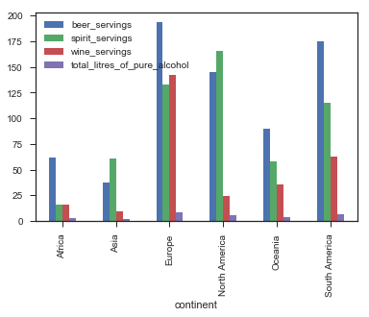

Slide 2
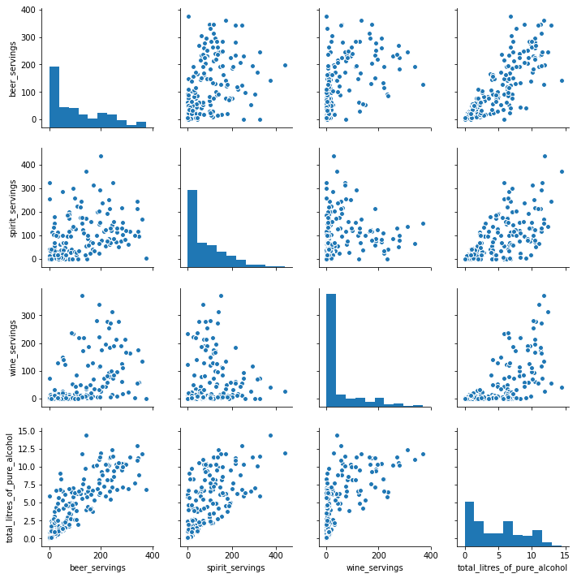
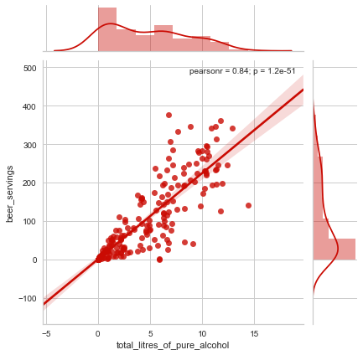
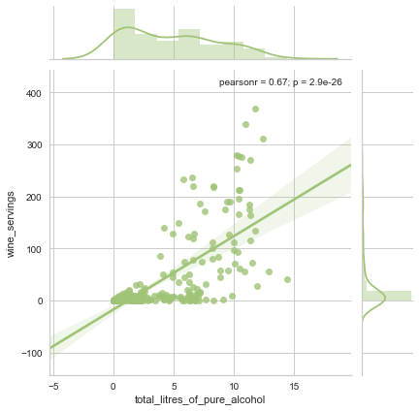
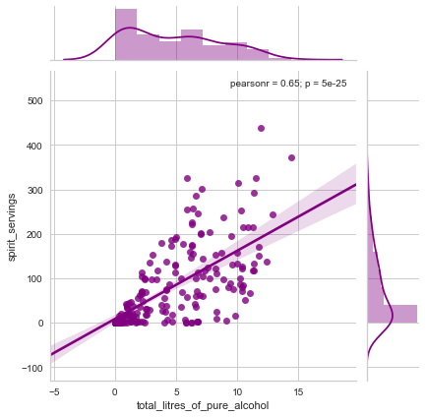

Slide 3
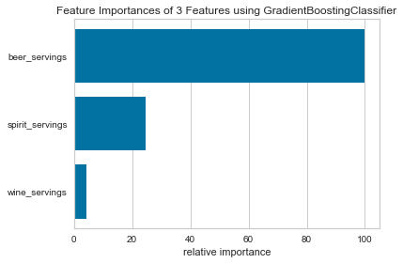
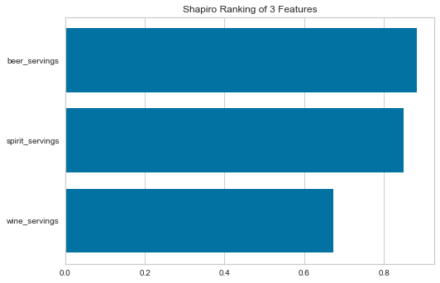
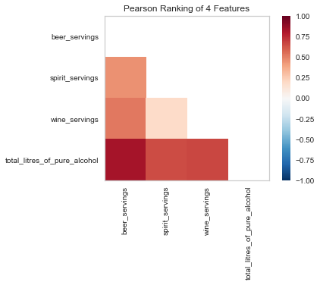

Slide 4
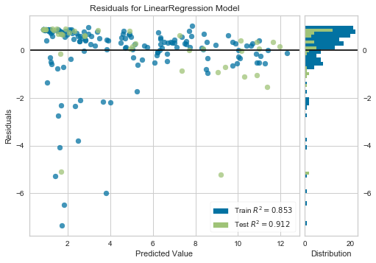
Linear Regression

Slide 5
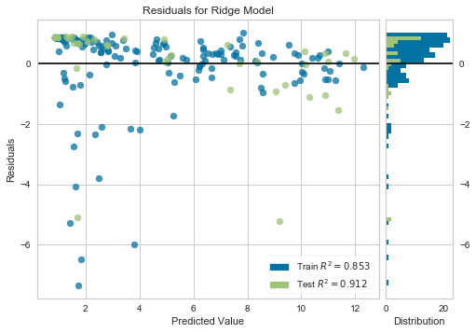
Ridge Regression

Slide 6
Random Forest Feature Importance
Feature | Relative Importance
Beer | 0.887
Spirit | 0.019
Wine | 0.094

Slide 7
Random Forest Feature Importance
Feature | Asia | Europe | Africa | NA | SA | Oceania
Beer | 0.770 | 0.846 | 0.892 | 0.345 | 0.386 | 0.153
Spirit | 0.846 | 0.083 | 0.050 | 0.410 | 0.375 | 0.736
Wine | 0.018 | 0.070 | 0.057 | 0.245 | 0.238 | 0.121

